Slide 1
Recent Advancements in Sugarcane Genomics

Slide 2
Genetics, Genomics and Epigenetics
Genetics:
study of genes and heredity
Genes:
A gene is a segment of DNA that contains instructions for building one or more molecules
Genome:
The total number of genes (genetic information) present in a organism.
Epigenetics: study of the chemical modification of specific genes or gene-associated proteins of an organism

Slide 5
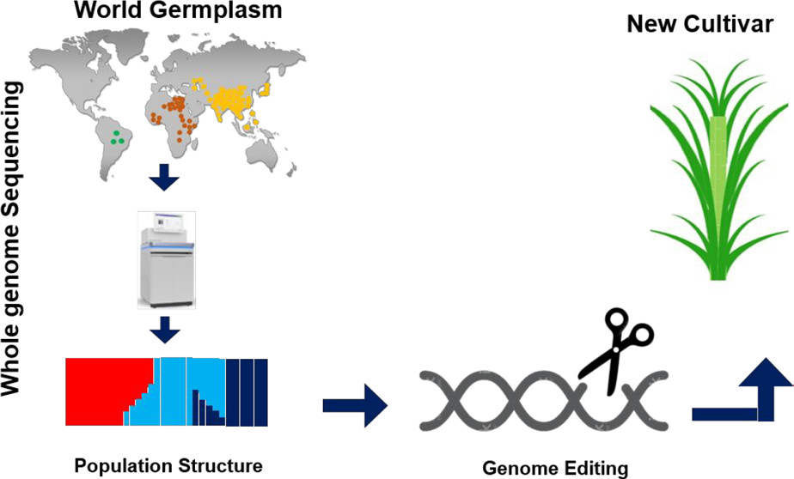

Slide 6
Sugarcane Breeding Constraints and Challenges

Slide 7
Sugarcane as Complex Genome
High polyploidy level (Octoploid)
Highly Heterozygous nature of its genome
Differ in Chromosome number (genotype to genotype) range 80 to130
Total size of sugarcane genome is about 10 Gb which is;
Three (3) times larger than human genome
Ten (10) times lager than the closely related species Sorghum
Twenty (20) times lager than the rice genome
No diploid progenitors of sugarcane,

Slide 8
Source: (Prathima P. etal. 2018).
Scheme of the sugarcane hybrid nuclear sub-genomes and the genetic contributions of each parental species, the chloroplast genome and the mitochondrial genomes

Slide 9
Genome Editing Technologies
Genome Editing:
Mechanism of DNA recombination which involves the initiation breaks with the double strand DNA followed by repair by the endogenous DNA polymerase.
Three steps involved in Genome editing:
Target the locus
Delete or insert a gene
Repair the DNA strand

Slide 10
Genome Editing Technologies
Conventional techniques such as gene knockout using P-element and transposons elements have been superseded by more accurate genome editing methods like ZFN, TELENS and CRISPR/Cas 9.
Following are different types of genome editing technologies:
Zinc Finger Nuleases (ZFN)
Transcriptional activators like effector nucleases TALENS
Clustered regularly interspaced short palindromic repeats (CRISPR-associated protein-9)

Slide 11
Zinc Finger Nucleases (ZFN)
ZFNs are fusions of zinc-finger based DNA recognition modules and the DNA cleavage domain of the Fokl restriction enzyme.
Each individual zinc finger typically recognizes and binds to a nucleotide triplet and fingers are often assembled into groups to bind to specific DNA sequences.

Slide 12
Zinc Finger Nucleases (ZFN)
Zinc Finger Motif
Characteristics:
3 D Structural motif of the proteins
Co-ordination of one or more Zn ions.
Zinc+ is helped in place by two histidine
R group
Present in Tandem repeats
Interacting with DNA or RNA
Zinc ion holding the structure together.
Zinc Motif consist of 30 Amino acids and folds into beta alpha structure
Each finger binds to a triplet within the DNA substrate.

Slide 13
Zinc Finger Motif
Functions:
DNA recognition.
RNA packing.
Transcriptional activities
Regulation of Apoptosis.
Protein folding and assembly
Lipid binding.
The Zinc ions found in 8% of all the human proteins, plays as important role in the organization of their three dimensional structure.

Slide 14
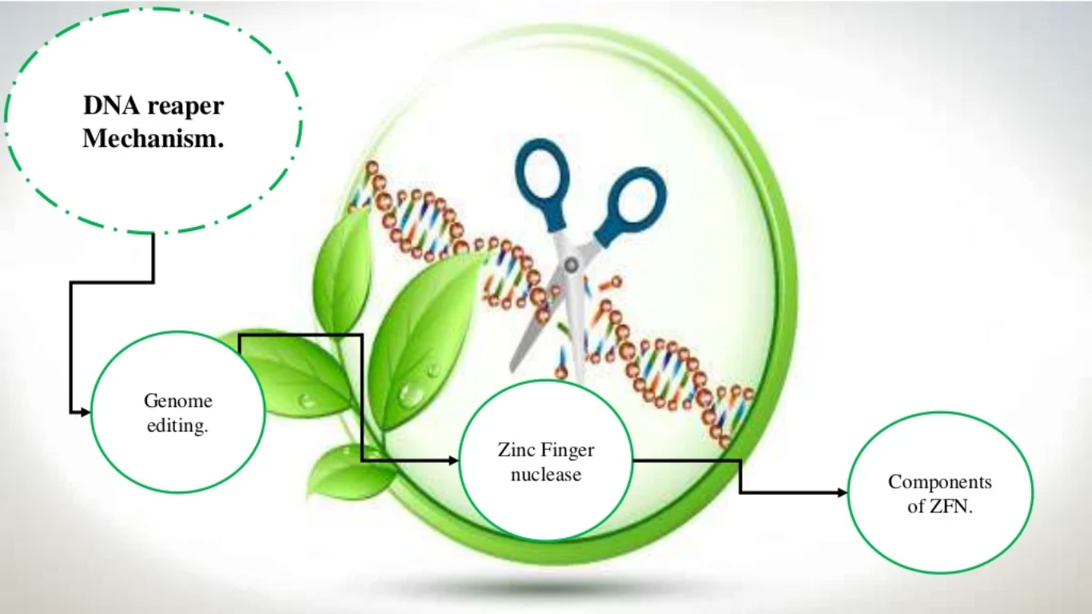

Slide 15
DNA Repair Mechanism
Double Strand Break:
Endonucleases create specific double strand breaks (DSBs) at desired locations in the genomes
Harness the cells endogenous mechanisms to repair the induced break by
Natural process of homologous recombination (HR) and non-homologous end joining (NHEJ)

Slide 17
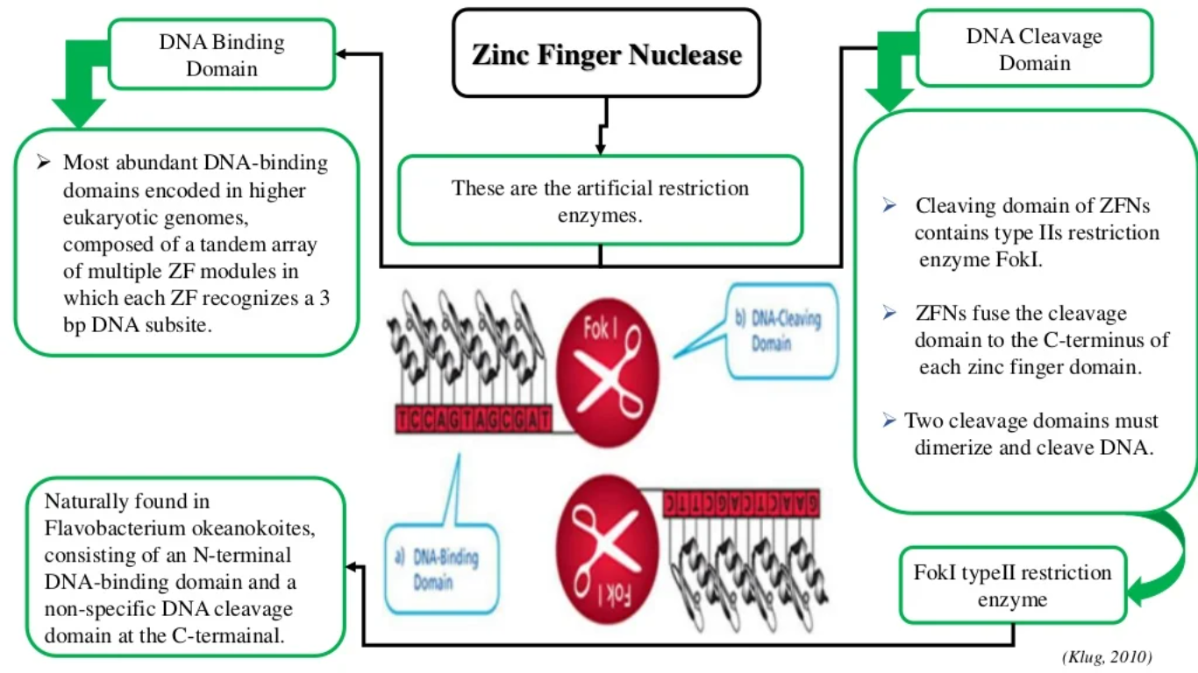

Slide 18
Working of Zinc Finger Nucleases
Double Strand Break (DSB):
Two ZFNs with different sequence specific sites collaborate as a hetero-dimer to produce a DSB.

Slide 19
Applications Zinc Finger Nucleases
Functional Genomics / Target Validation
Creation of gene knockout in multiple cell lines
Complete knockout of gene not amenable by RNA-I
Cell Based Screening
Creation of Knock in cell line with promoters, fusion tags or reporters integrated into ungenerous genes.
Cell Lines Optimization
Creation of Cell lines that produce high yield of proteins or antibodies

Slide 20
Limitations of Zinc Finger Nucleases

Slide 21
TALENS
TALENs, or transcription activator-like (TAL) effector nucleases, are widely used for precise and efficient gene editing in live cells.
TALENs are fusion of TALE repeats and the Fokl restriction enzyme.
Each individual of TALE repeat target a single nucleotide, allowing for more flexible target design and creating the number of potential
TALENs can target any desired sequence within a genome, with no PAM (Proto-spacer adjuscent Motif) site restrictions.

Slide 22
TALENS
Specifically, TALENs consist of a DNA binding domain linked to a specific effector domain (e.g., Fok1 nuclease).
Our Invitrogen Flex-Cut TALEN mRNA pairs are an all-in-one solution to perform either knockout or knock-in genome editing.
They are available in a convenient transfection-ready mRNA format to accelerate your gene editing experiments.

Slide 23
Typical Structure of TALs
Central repeat domain
Number of repeats 1.5 to 33.5.
Each repeat consist of 34 residues.
Short repeat at the Carboxyl terminal end.
Hyper-variable residues: position 12 and 13.
Structure: two alpha helices.

Slide 24
How to we engineer TALEN
Combinations of amino acid bind to specific nucleotides
This code has been deciphered
It is now possible to engineer TALs to target specific DNA sequence
TALs can be fused to functional domains and applied to edit the genome

Slide 25
Structure of a TALEN
The DNA binding motifs are engineered based on the coding amino acids in TAL motif.
The DNA sequence of the restriction enzyme Fokl is fused to the DNA sequence for the TAL repeats resulting in the creation of a chimeric enzyme which can target specific regions of the DNA.

Slide 26
Engineering the TALENS

Slide 27
How do TALENS Work?
A pair of TALENS, one specific to each region flanking the targeted locus (black) are transfected into the cell and expressed in vivo.
Upon expression the Fokl domain restricts the DNA on either side of the locus resulting in a double stranded break.

Slide 28
How do TALENS Work? Deletion
The DNA repair mechanism attempts to repair the gap by a process known as gap filling.
It recruits DNA polymerase and DNA repair enzymes.
However in the absence of either of the template strands, the gap is repaired without the gene.
This results in a gene deletion.

Slide 29
How do TALENS Work? Insertion
If we induce a DNA fragment with a homologous recombination site that matches the regions flanking the deletion, the DNA fragment integrates into the double stranded break. This result in a gene insertion.

Slide 30
What is CRISPR?

Slide 31
i. CRISPR-Cas systems mediated genome modification depending on the two main double-strand break (DSB) repair pathways.
ii. Indel mutation and gene deletion are outcomes of the dominant non-homologous end joining (NHEJ) repair pathway.
iii. Gene insertion, correction, and replacement, using a DNA donor template, are outcomes of the homology directed repair (HDR) pathway.

Slide 32
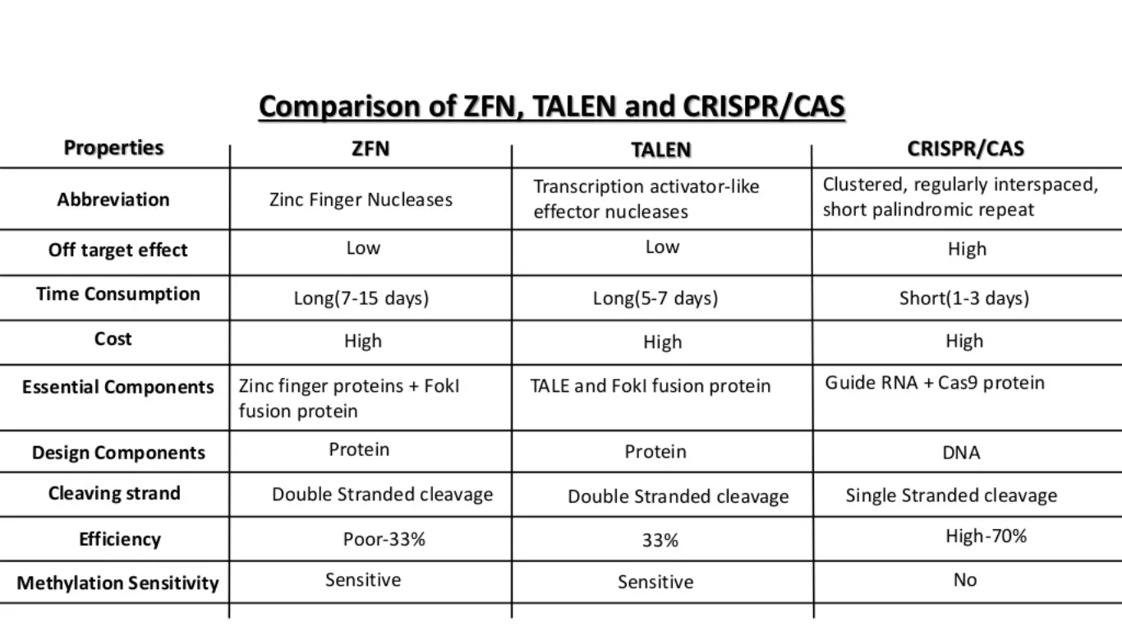
Comparison of ZEN, TALENS and CRISR/CAS

Slide 33
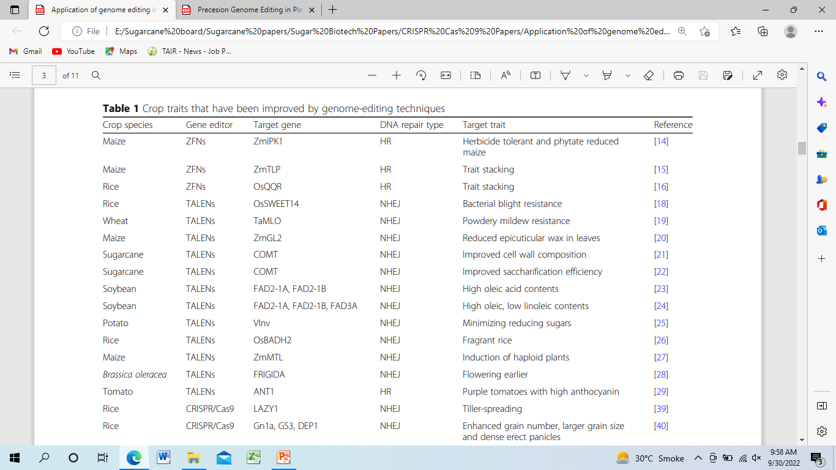
Improved Crop Traits By Genome Editing Techniques
Source: Zhang et al. Genome Biology (2018)

Slide 34
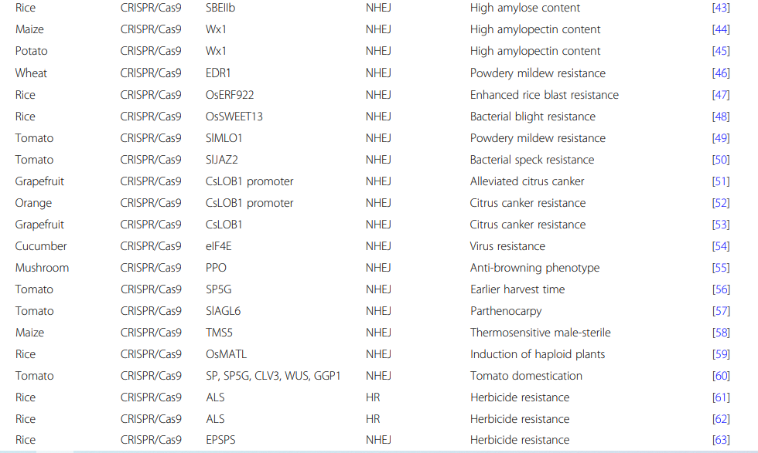
Improved Crop Traits
Source: Zhang et al. Genome Biology (2018)

Slide 35
Conclusion
Genome Editing is a powerful tool which is expected to play a crucial role in sugarcane crop production to fulfill the needs of population under a climate change scenario.
Conventional breeding methodologies, the molecular breeding strategies aided by genome editing tools allow scientists to precisely target and edit for desired traits.
Genome editing enhanced crop productivity, nutritional value, and develop resistance against biotic as well as abiotic stressors by improving the crop genome.
Edit crops have been utilized in several breeding platforms for carrying the desired trait for the development of an elite local sugarcane variety.

Slide 36
Conclusion
Modern plant breeding approaches for sugarcane will increase the performance of plant breeding, and gene-edited elite cultivars can be approved for cultivation in specified locations.
For the last two decades SSNs such as ZFNs, and TALENs have revolutionized plant genome editing.
These techniques used for gene insertion, gene deletion, and increasing the efficiency of homologous recombination which allows for more precise and accurate events of gene replacement.

Slide 37
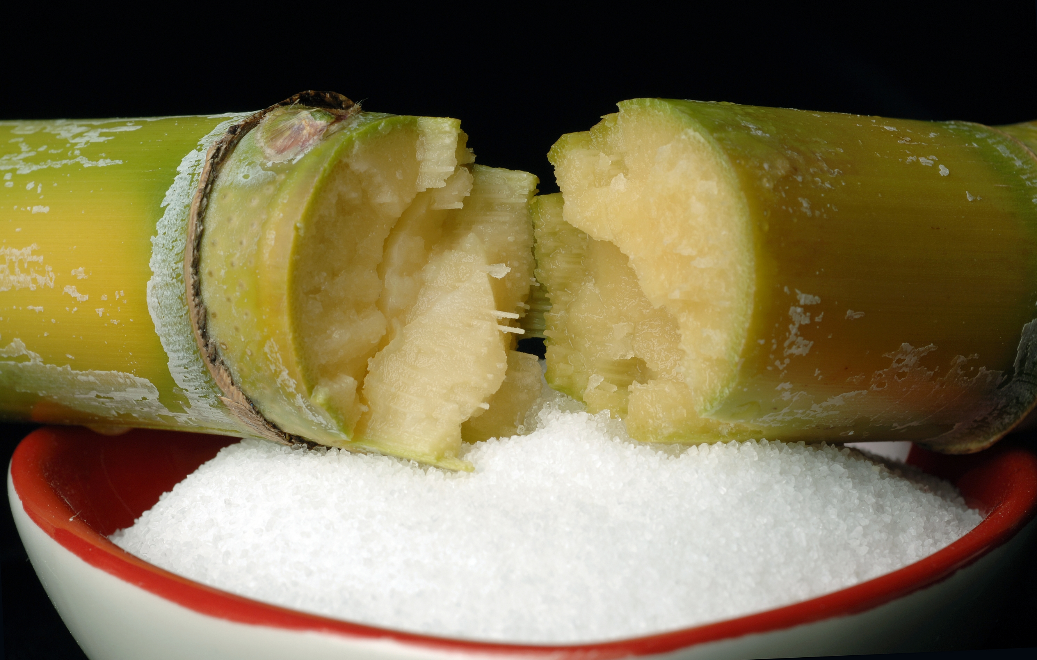
THANK YOU

